Slide 1

Zarr
A Storage Format for Chunked, Compressed ND-Array
@ Vrije Universiteit Amsterdam 🇳🇱
~Sanket Verma

Slide 2


About Me
~ Takes care of the community & OSS @ Zarr
~ Chair @ PyData Delhi and Global ‘20 & ‘21
~ Worked with forensics, startups, organisations
~ Sometimes I play the Violin
/msankeys963
Notes:
Tell about yourself.

Slide 3

Repository 👇🏻

Slide 4

Slides 👇🏻

Slide 5


What I’m gonna show you?
What is Zarr? How Zarr works?
Zarr Datasets
Some code
Zarr Community & Future Goals

Slide 6

What is Zarr?
Zarr is open-source specification format for storing chunked, compressed, N-dimensional arrays.

Slide 7
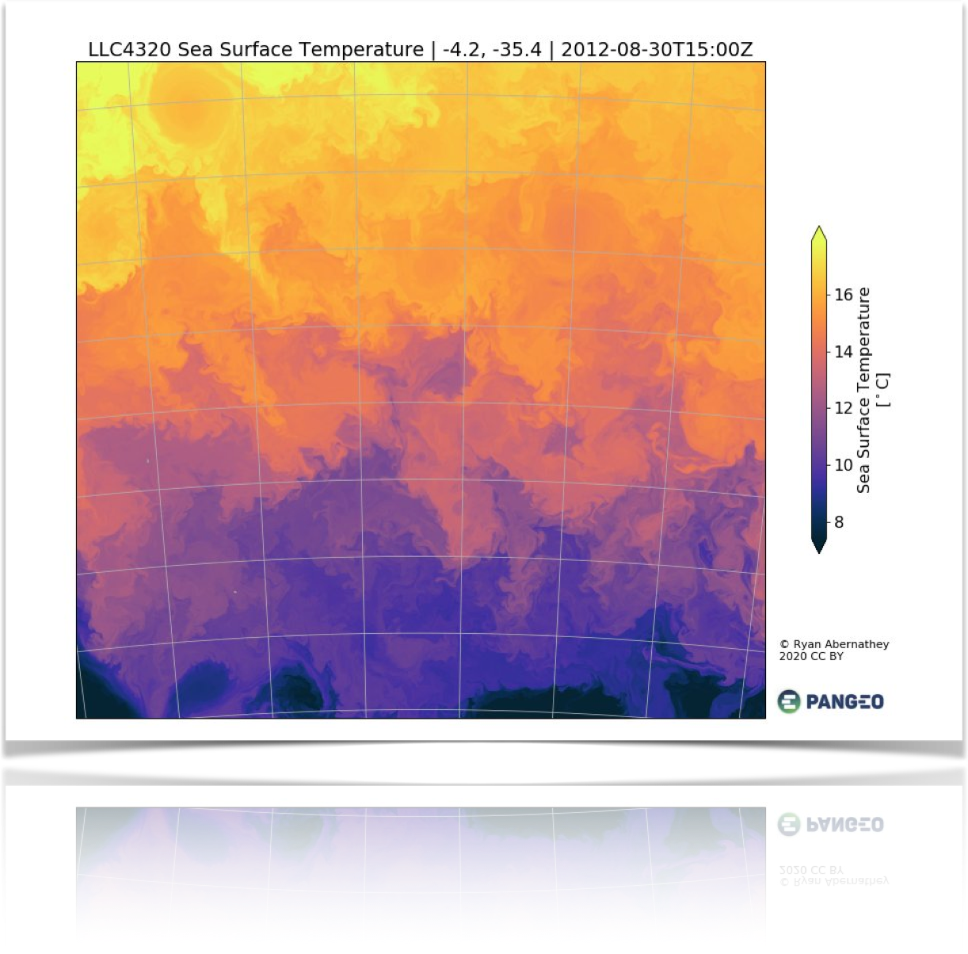
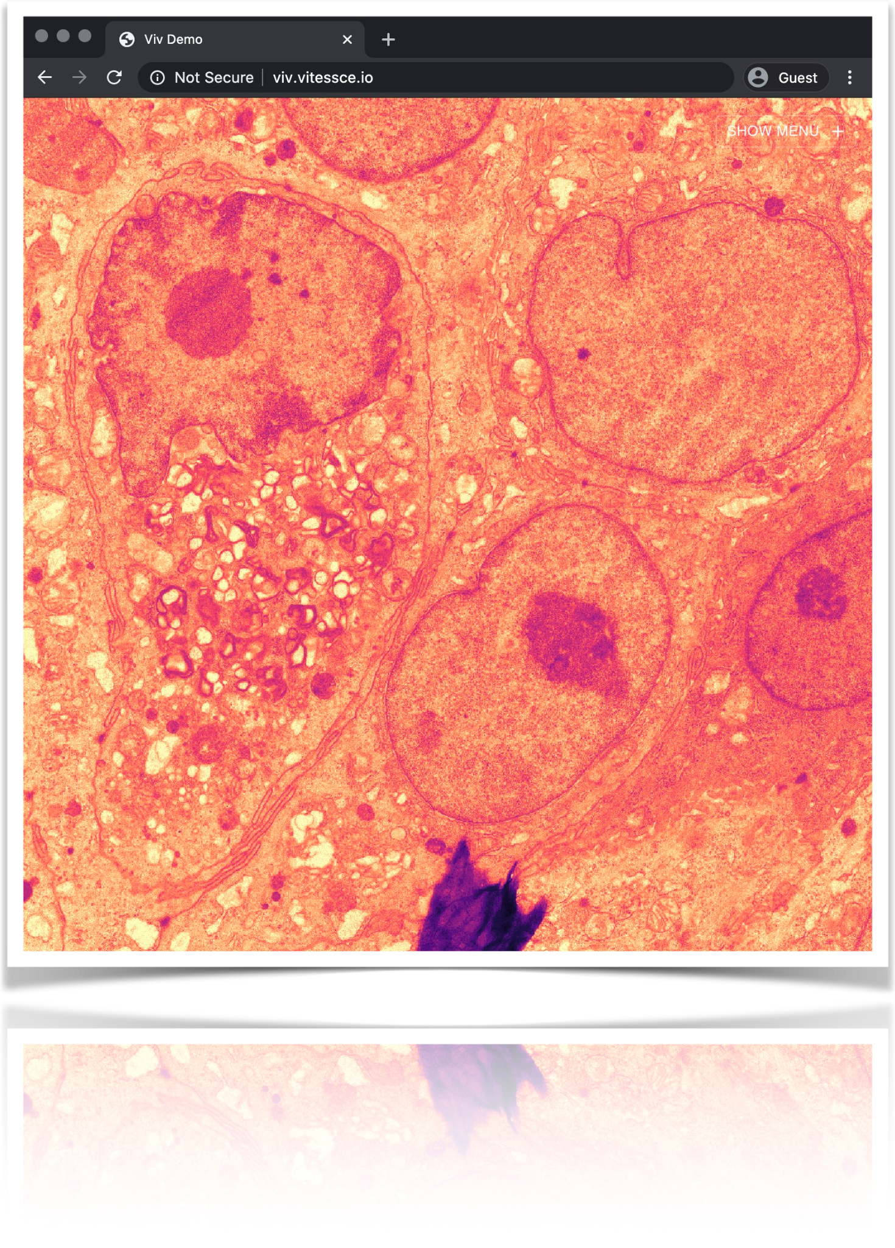
Zarr is a Generic Format For Scientific Array Data
Oceanography (~54 TB)
Microscopy (30GB)
https://twitter.com/LLC4320Bot/status/1274862822778982402
https://twitter.com/trevmanz/status/1265377097981329423
Notes:
Some 100GBs for Oceanography and 30GB for COVID-19 microscopic image.

Slide 8


Inception of Zarr! 👶
~ Created by Alistair Miles (Oxford Geneticist; @alimanfoo) in 2015
~ Rapidly growing user-base and industry ready
~ Currently has 21 core-devs for Zarr-Python
~ Fiscally sponsored by NumFOCUS
~ Funded by CZI under EOSS
/zarr_dev /zarr-developers https://zarr.dev/

Slide 9
What is an array?
Let’s have a look at what array/tensor is?

Slide 10
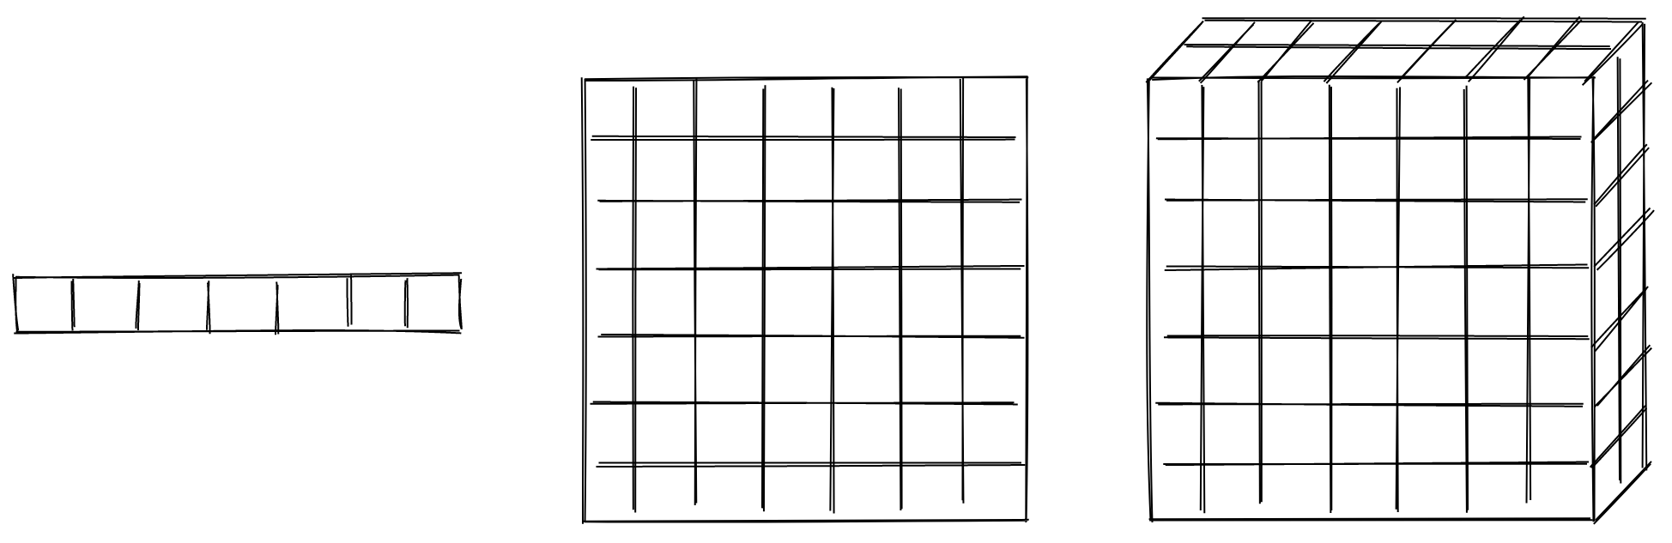
What is an array/tensor?
A container of items
Credits: Trevor Manz (@trevmanz)

Slide 11
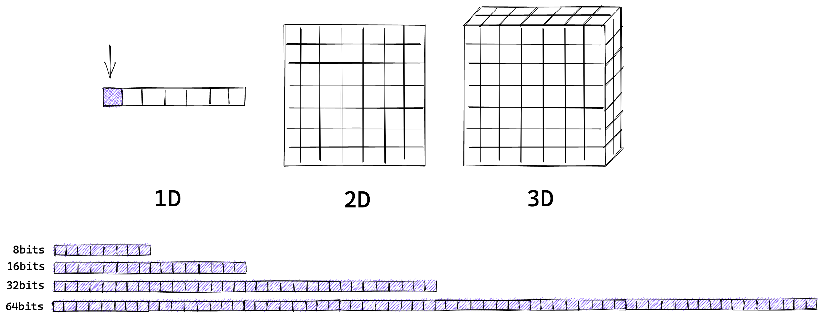
What is an array/tensor?
A container of items of the same data-type and size (in bits)
Credits: Trevor Manz (@trevmanz)

Slide 12
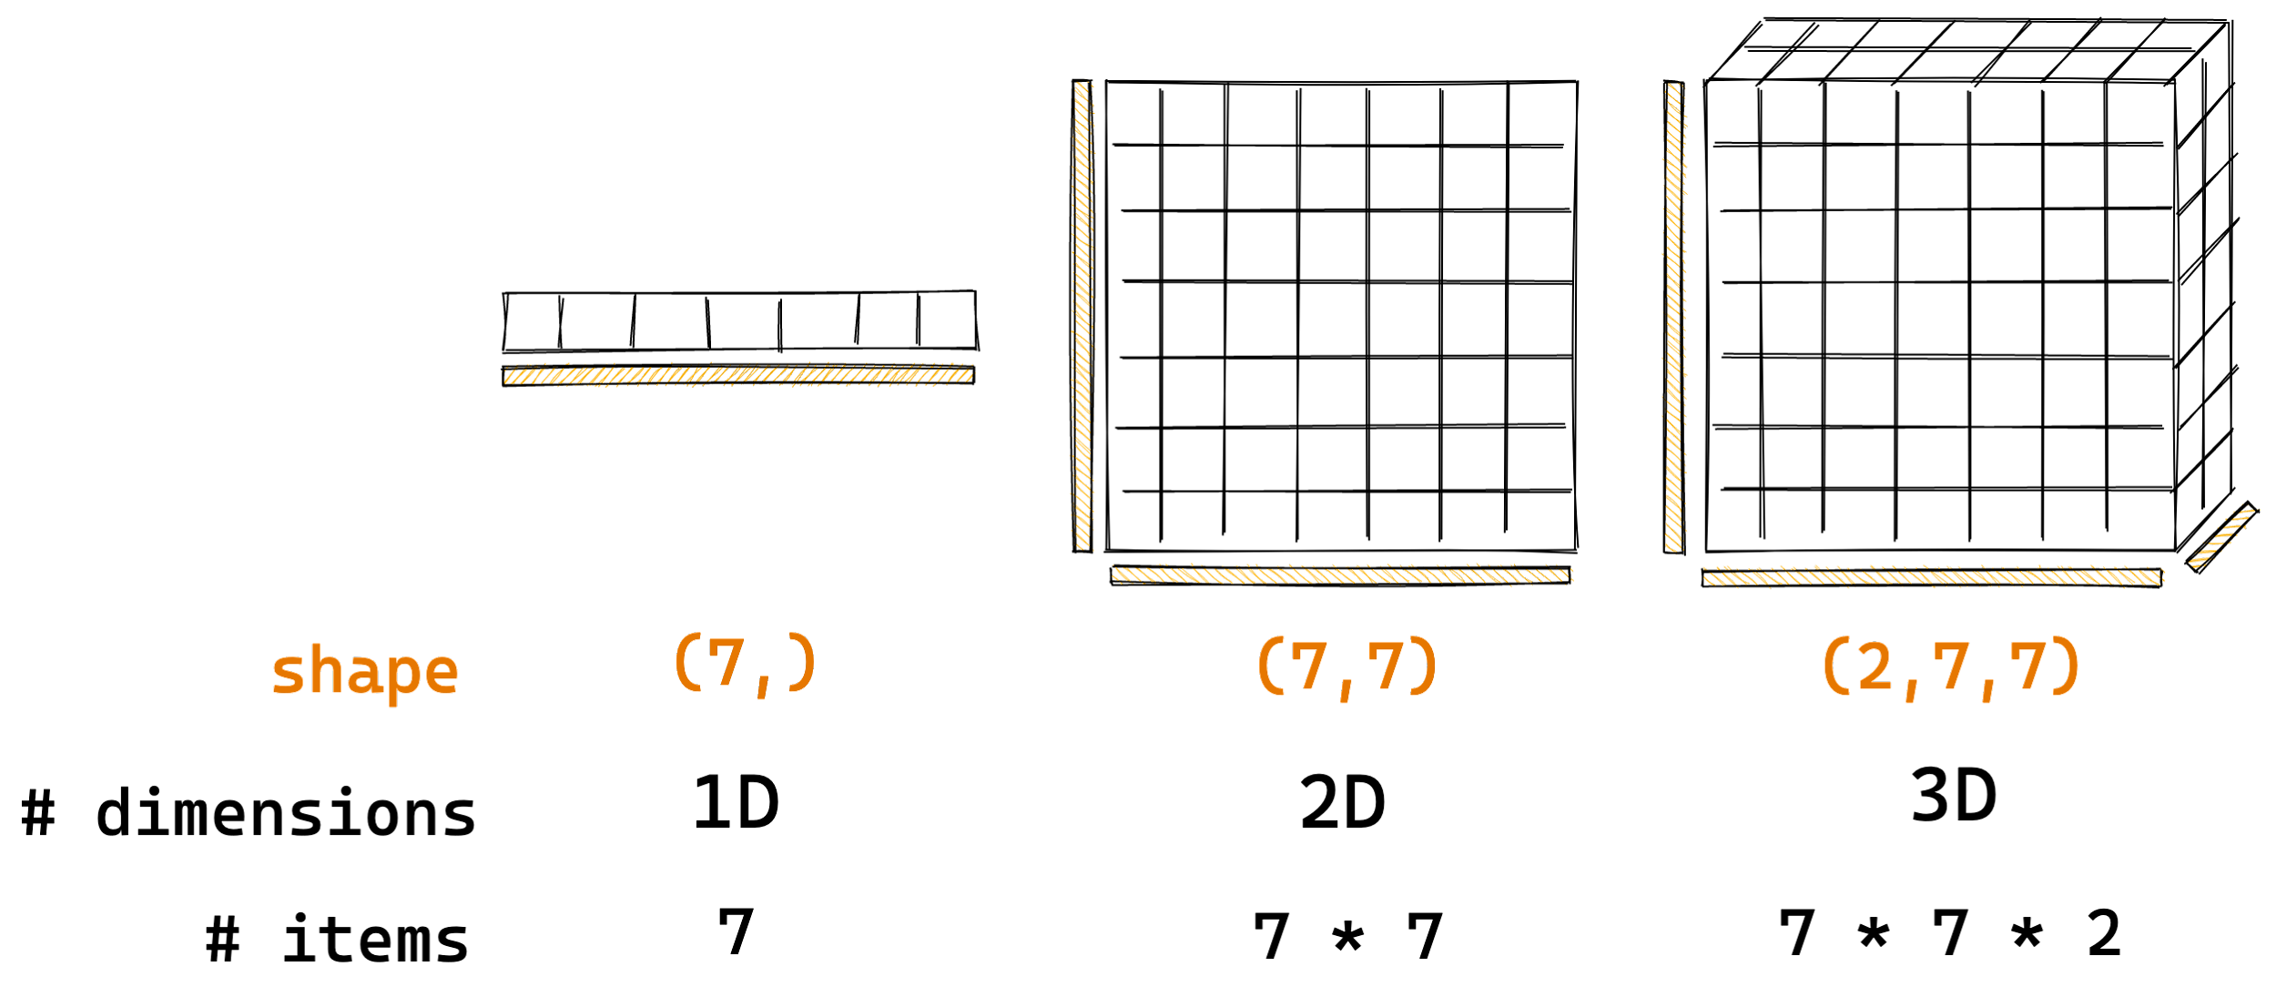
What is an array/tensor?
The number of dimensions and items in container are described by the shape
Credits: Trevor Manz (@trevmanz)

Slide 13

How Zarr works? 🤔
Credits: Trevor Manz (@trevmanz)

Slide 14
How Zarr works? 🤔
What if the data is too big to fit in memory

Slide 15
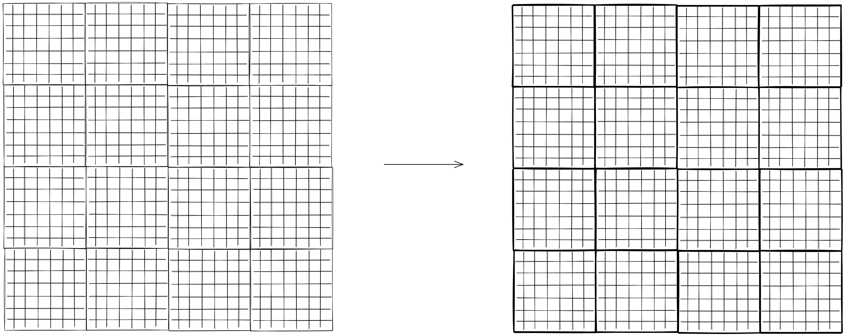
How Zarr works? 🤔
Divide array into chunks
Credits: Trevor Manz (@trevmanz)

Slide 16
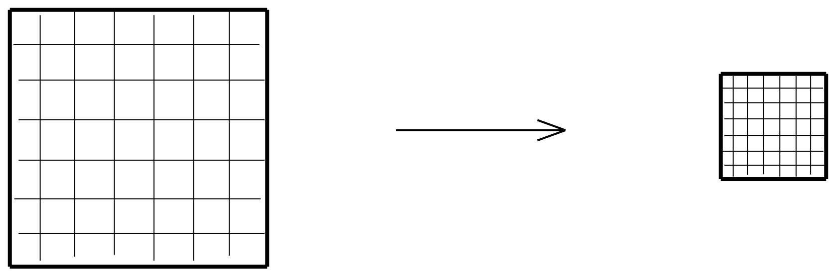
How Zarr works? 🤔
Compress each chunk Over 20 supported compressors (BLOSC, Zstd, Zlib, LZMA, Shuffle, etc) https://numcodecs.readthedocs.io/en/stable/
Credits: Trevor Manz (@trevmanz)

Slide 17
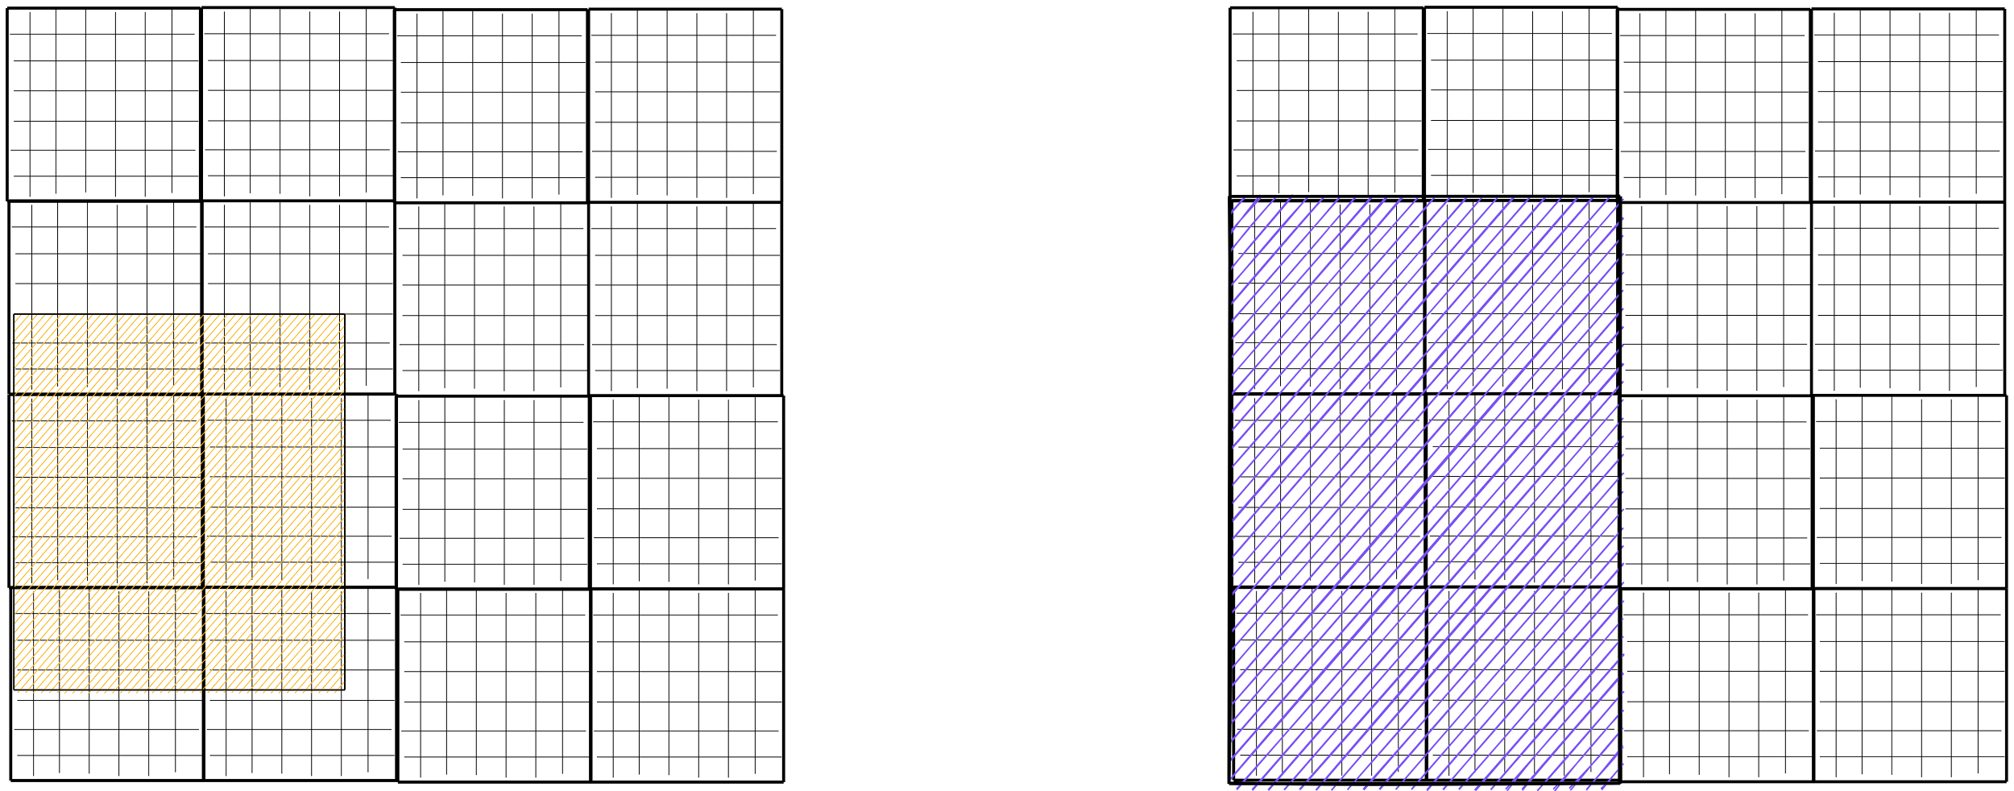
How Zarr works? 🤔
Retrieve chunks only when needed
Credits: Trevor Manz (@trevmanz)

Slide 18
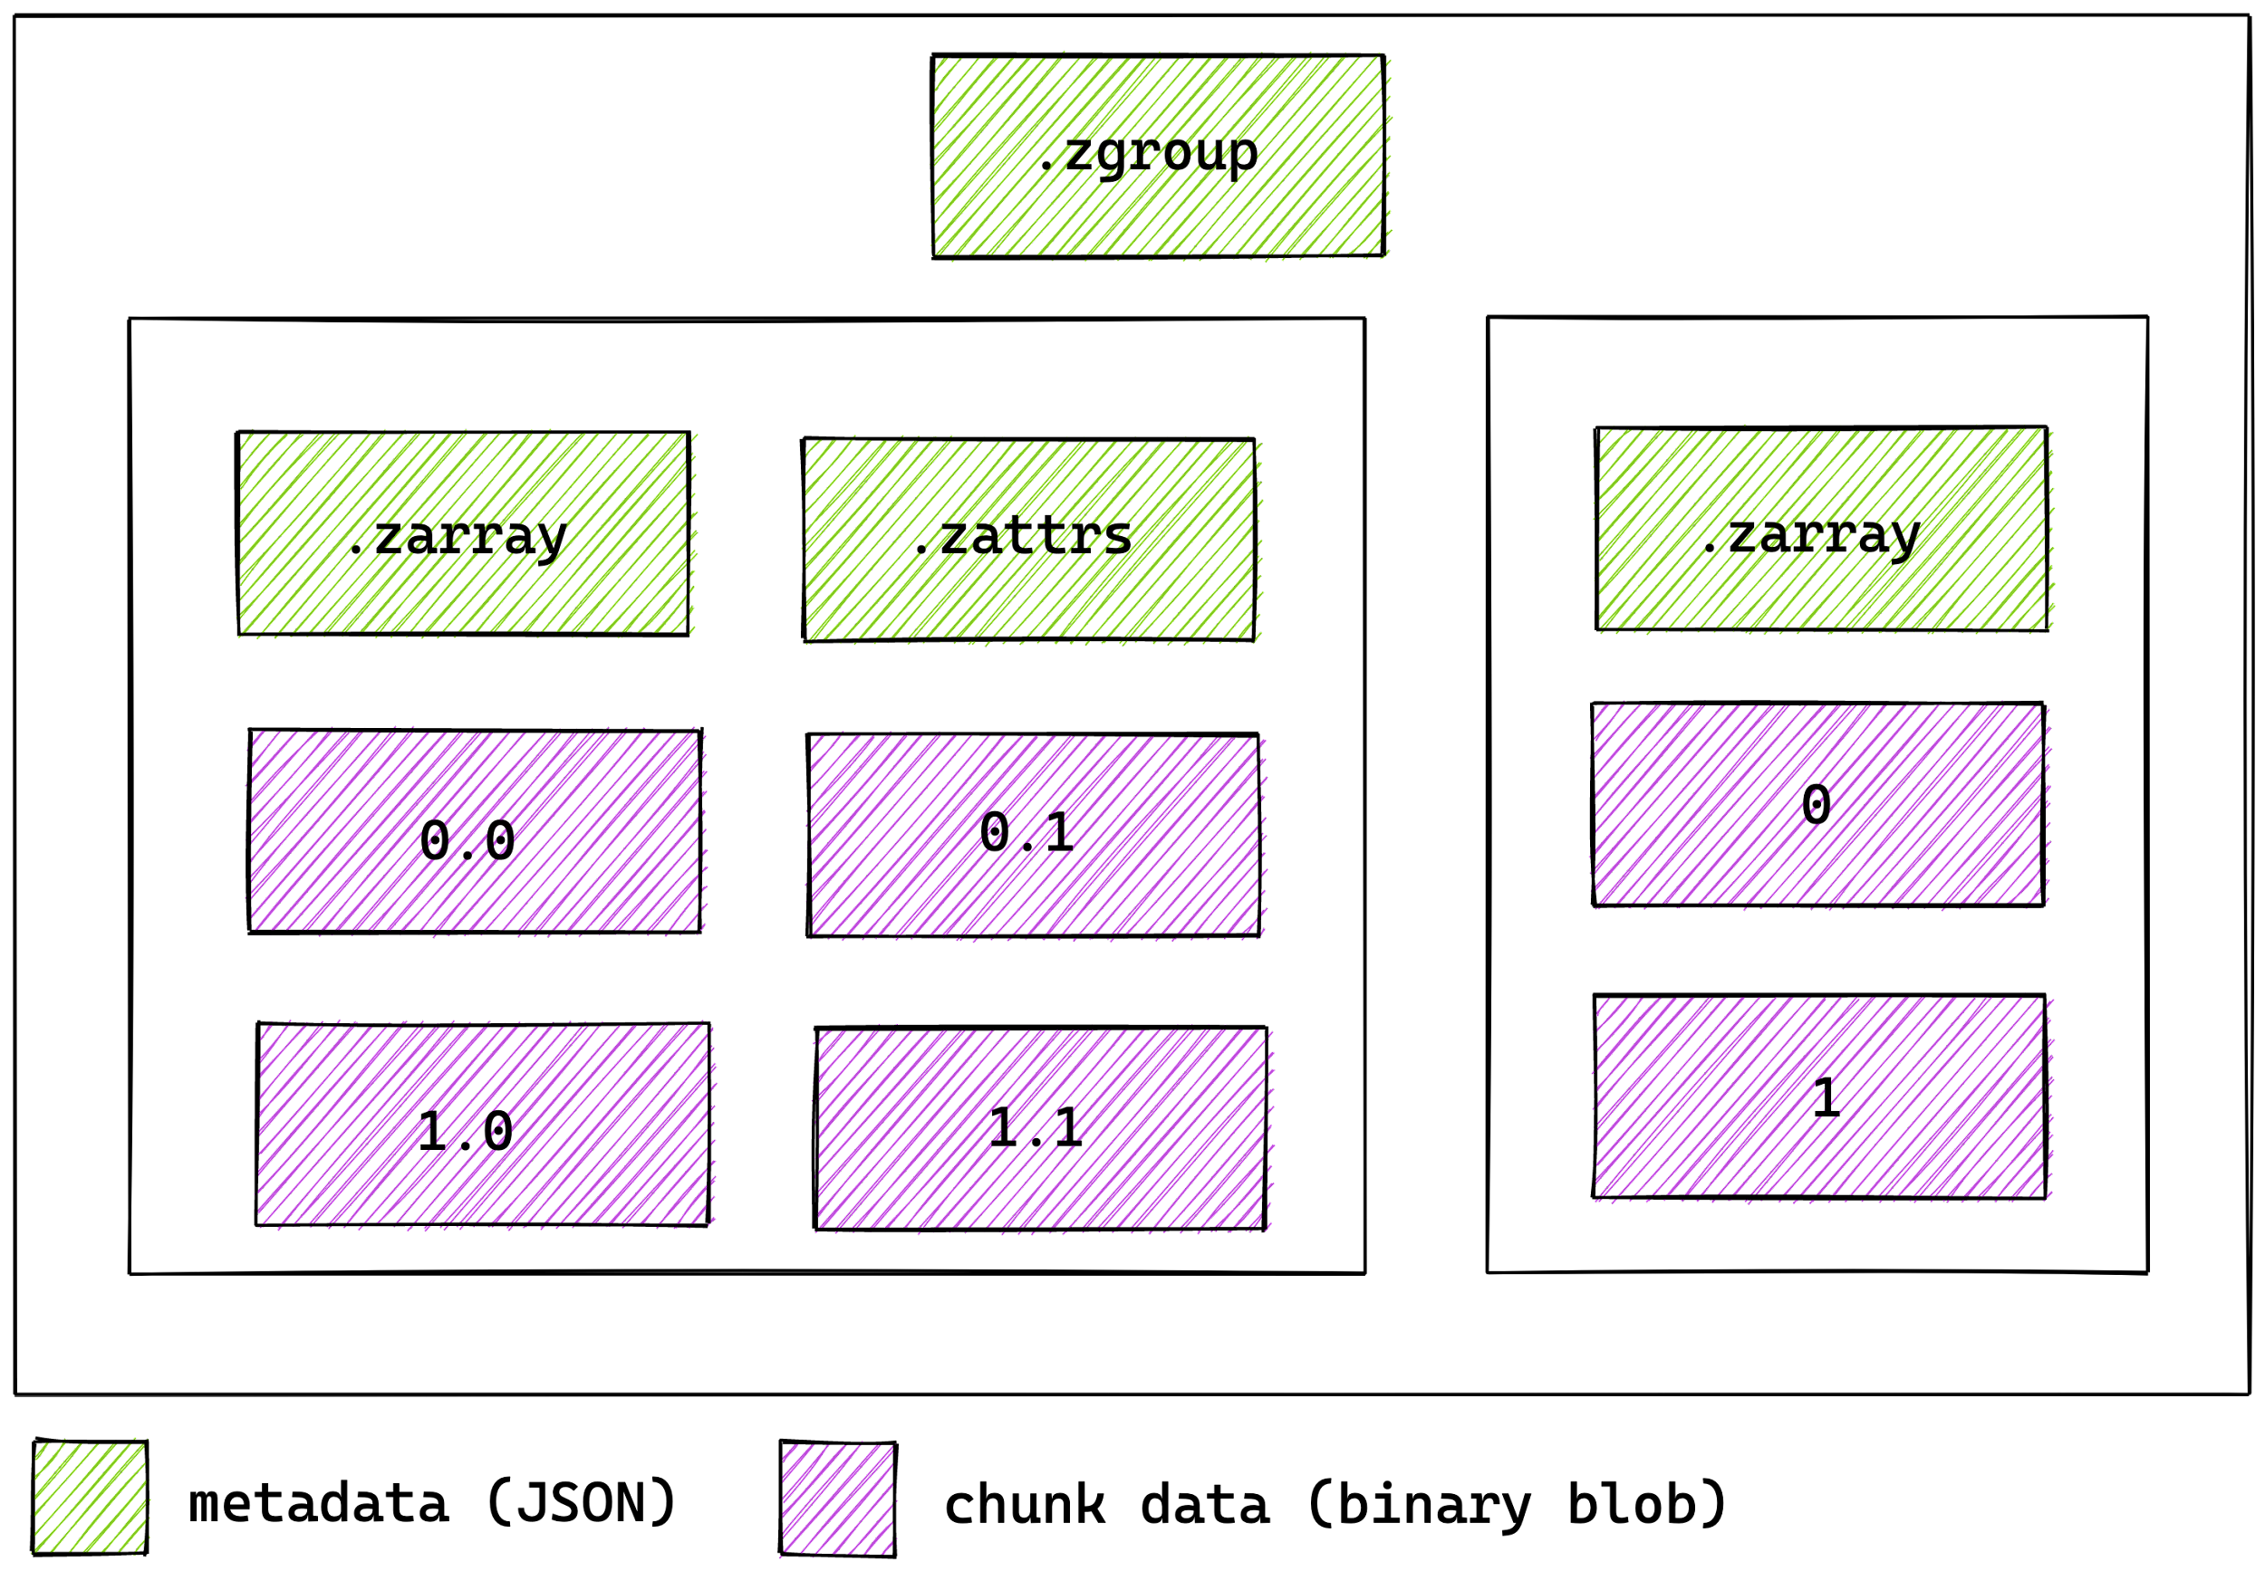
How Zarr works? 🤔
Multiple arrays can be organized in hierarchies of groups

Slide 19
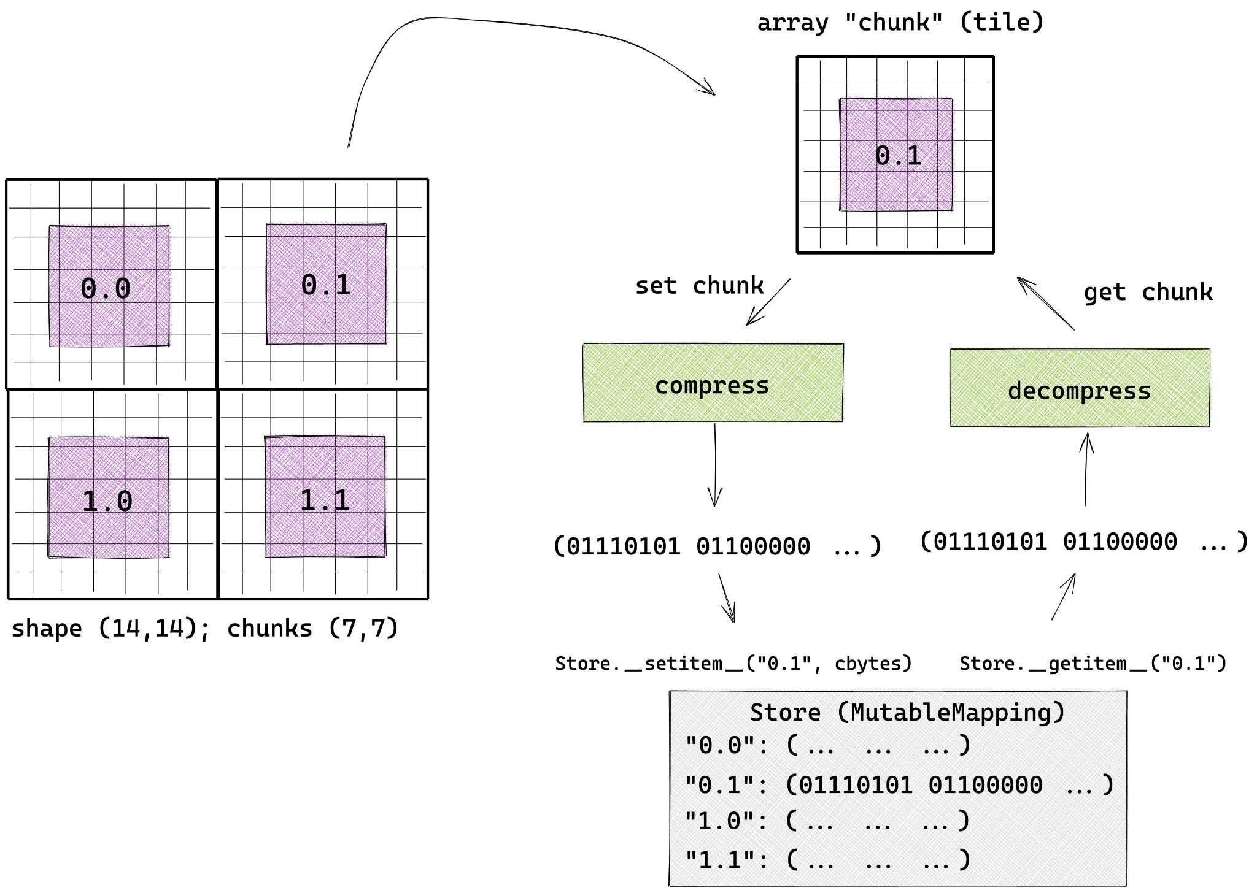
How Zarr works? 🤔

Slide 20
Zarr is a Generic Format For Scientific Array Data
Oceanography (~54 TB)
Microscopy (30GB)
https://twitter.com/LLC4320Bot/status/1274862822778982402
https://twitter.com/trevmanz/status/1265377097981329423
Notes:
Some 100GBs for Oceanography and 30GB for COVID-19 microscopic image.

Slide 21
Zarr Datasets! 💾

Slide 22

MUR Sea Surface Temperature (54TB)

Slide 23

Climate Model Data CMIP6 (1 PB) 🌏

Slide 24

National Water Model (5 TB) 🌊

Slide 25

Let’s see some code! 🧑🏻‍💻

Slide 26

Documentation 📖

Slide 27
Why use Zarr? 🤓
~ Chunk arrays along any dimension
~ Arrays can be read & written concurrently from multiple threads/processes
~ Easy to extend, append, etc.
~ Extensive compression support + easy to plug-in new compressors
~ Support local and cloud storage systems (any key-value store)
~ Simple and based on open specification which allows it to be hackable!
Notes:
Mention the benefits of chunking!

Slide 28
When to use Zarr? 🤓
~ When you have absurdly large datasets!
~ When you want to share big datasets across multiple points (having key-valued chunks really helps this)
~ If you’re looking for a transparent OS data format with an awesome community!
~ And, to be cool among your friends and colleagues! 😎

Slide 29
How Zarr is different? 🤔

Slide 30
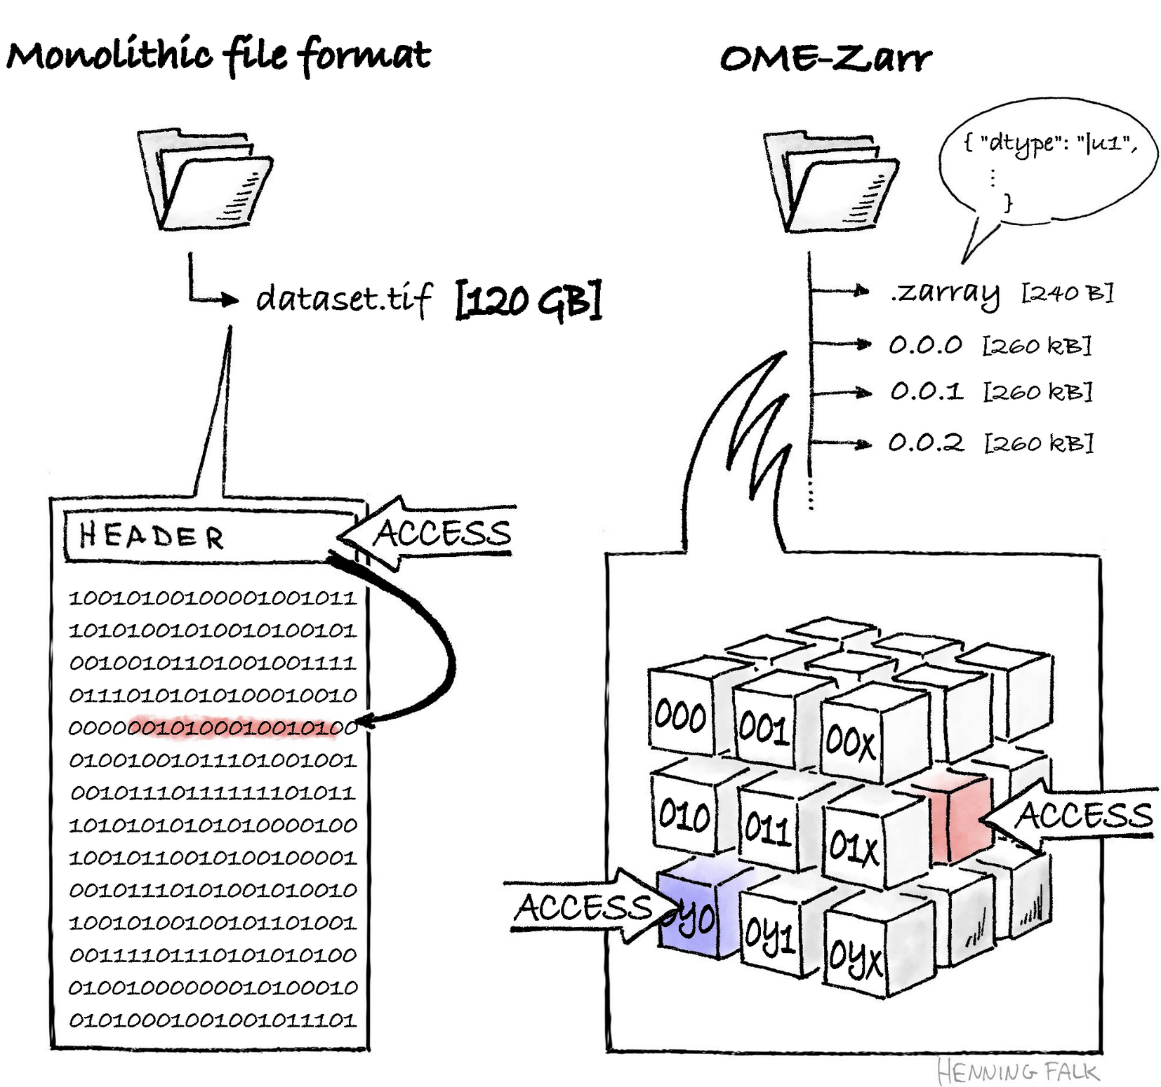

Slide 31
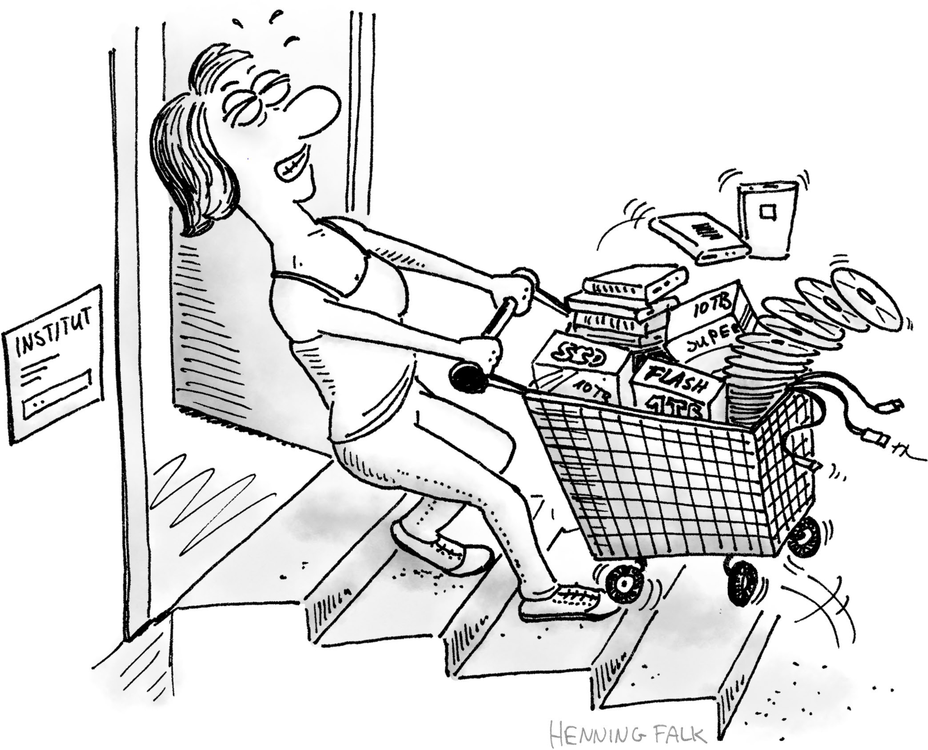

Slide 32
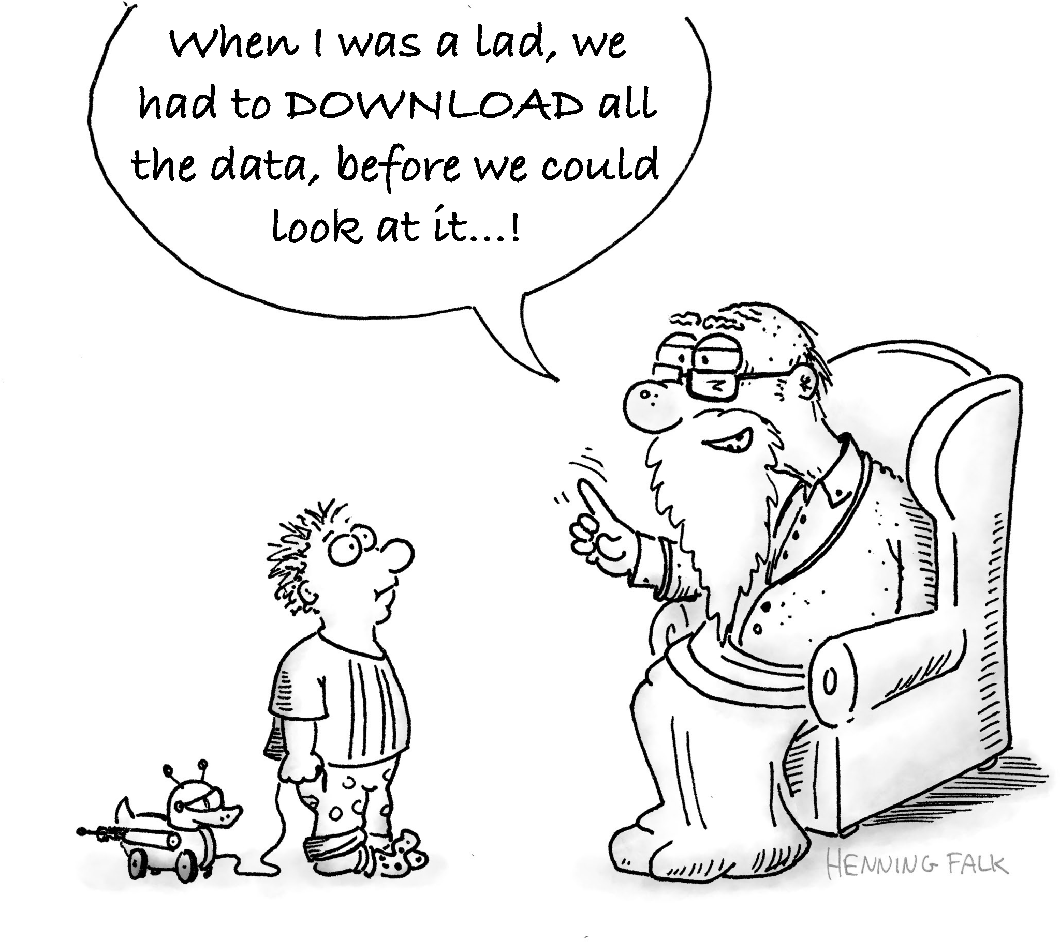

Slide 33
More illustrations 👇🏻
https://bit.ly/zarr-drawings

Slide 34
The Zarr Specification 🧐
~ Provides a technical specification of the protocol and format for storing Zarr arrays
~ Currently V2 is in effect
~ Tells how hierarchies are organised, arrays are chunked and grouped, how metadata should look like etc.
~ V3 is out now! see ZEP0001
https://zarr-specs.readthedocs.io/

Slide 35
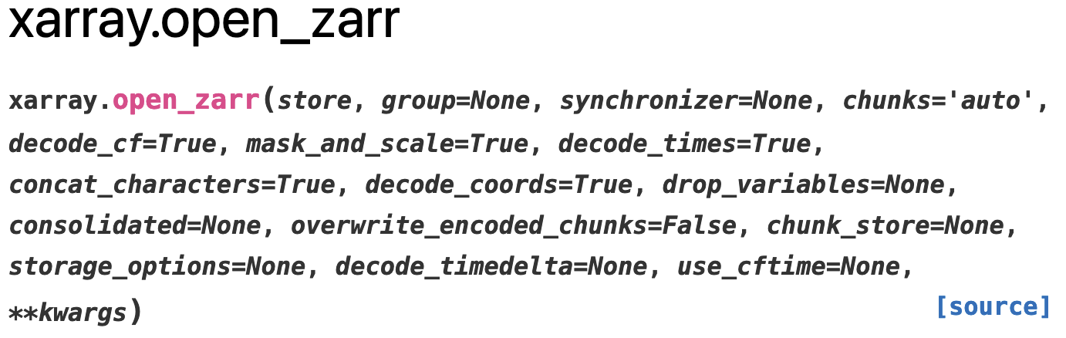
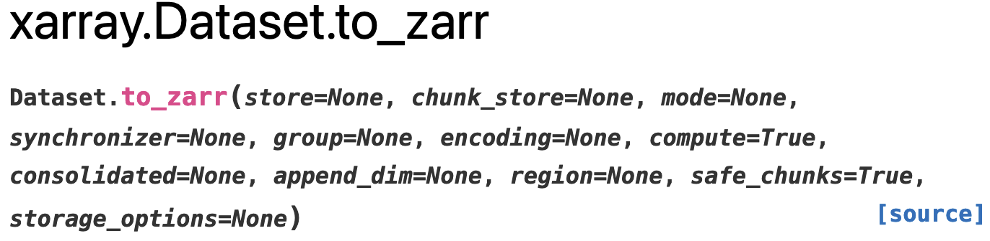
Interoperability! 🔗
~ Read and write to Zarr Stores using: Dask, Xarray, Anndata etc.

Slide 36
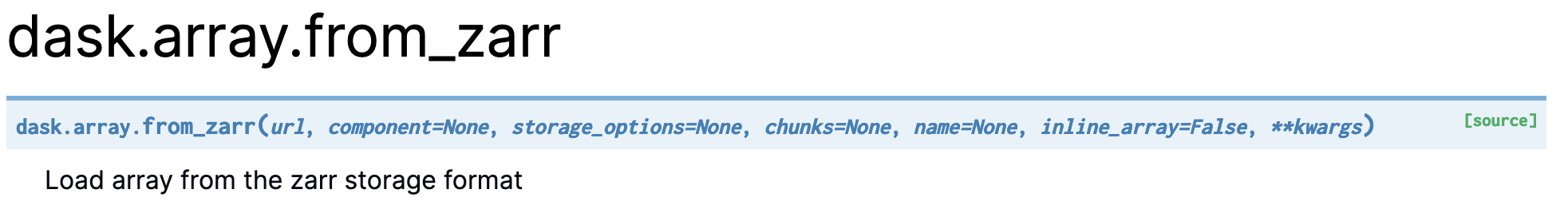
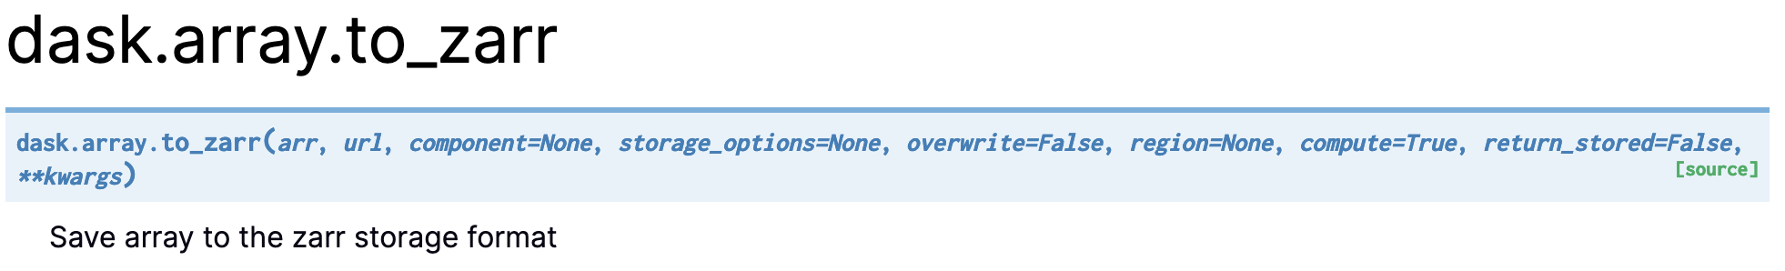
Interoperability! 🔗
~ Dask 👇🏻

Slide 37
Zarr Implementations 👇🏻
https://zarr.dev/implementations

Slide 38
Zarr Community & Future! 👨‍👩‍👧‍👦
~ What is the Zarr community and how you can join us?
~ ZEP: A community feedback process to implement changes to the Zarr spec
(https://zarr.dev/zeps/)
~ What does V3 looks like? Features?
~ Gitter: https://gitter.im/zarr-developers/community/

Slide 39


Example Zarr Cloud Datasets
CMIP6 dataset processed from ESGF NetCDF
>1 PB of data on AWS & GCS
>500K individual Zarr stores
L4 Sea Surface Temperature
One single big Zarr store 54 TB total

Slide 40
How Zarr is different? 🤔
~ Active community, rapid development
~ Implementations in several programming languages
~ Versatile data format; data conventions like GeoZarr, OME-Zarr, NCZarr
~ Interoperable with other libraries in the PyData Stack
~ Adopted by many groups → https://zarr.dev/adopters/

Slide 41
Thank you! 🙌🏻
/zarr_dev /zarr-developers https://zarr.dev/
You are welcome at our community meetings and office hours!
(https://zarr.dev/community-calls/)
(https://zarr.dev/office-hours/)

